Slide 1

CSE445 / CSE598
Distributed Software Development
Performance of
Multithreading and Asynchronous Computing
Yinong Chen (Ph.D.)

Slide 2
Lecture Outline
Multithreading for Performance
Architecture: HyperThreading and Multi-core processors
Synchronous vs. asynchronous function calls and their performance
Performance indicators: Speedup and efficiency
Case Study: Multithreading Performance Experiment Using Intel Many-core Testing Lab (32-Core Computer)

Slide 3
Multithreading and Multi-Core Architecture
Single-Threading:
Serial execution - One thread at a time.
Multithreading on Single Core
Multiple threads executed on one processor by using context switching.
HyperThreading Architecture (Hardware-level):
Two threads execute simultaneously on the same processor with additional threading logic.
Multi-Core Architecture:
Threads are distributed among the cores with True Parallel Computing
The benefit of threading will be limited in performance

Slide 4
Single Core and HyperThreading Processor
Instruction stream
Control Unit
Registers
Interrupt Logic
Single Core Processor
Execution Unit / Datapath
Integer ALU
Float ALU
Cache
It appears to OS to have two processors, resulting two threads are assigned to the processor. Executing two mixed threads will reduce instruction dependency for pipelined processor!
HyperThreading Processor: Allows to share the unused execution units
Control Unit
Registers
Interrupt Logic
Control Unit
Registers
Interrupt Logic
Execution Unit / Datapath
Integer ALU
Float ALU
Cache

Slide 5
Multi-Core and HyperThreading Processor
Control Unit
Registers
Interrupt Logic
Control Unit
Registers
Interrupt Logic
Execution Unit / Datapath
Execution Unit / Datapath
Integer ALU
Float ALU
Cache
Integer ALU
Float ALU
Cache
Multi-Core
Control Unit
Registers
Interrupt Logic
Control Unit
Registers
Interrupt Logic
Control Unit
Registers
Interrupt Logic
Control Unit
Registers
Interrupt Logic
Execution Unit / Datapath
Execution Unit / Datapath
Integer ALU
Float ALU
Cache
Integer ALU
Float ALU
Cache
Multi-Core with HyperThreading

Slide 6
Intel’s Software Support to Multi-Core
One of the Intel’s solutions: Intel® Threading Building Blocks (Intel® TBB)
TBB is a set of library functions primarily designed for optimizing computation-intensive applications, such as graphics processing in gaming.
TBB can enhance the performance of these applications with relatively small amounts of coding effort.
Even for a serial application, TBB techniques demonstrate straightforward ways of introducing performance threading.
Notes:
Since, developers were still writing code for single thread, intel released the above lib to make multi-threading appns coding easier.

Slide 7
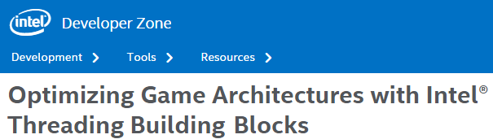
Key Ideas of Intel® TBB
Improve parallel computing possibility by:
Turning synchronous (blocking) calls into asynchronous (non-blocking) calls using event-driven programming paradigm.
Converting nested (vertical) method calls (threads) into flat method calls.

Slide 8
Synchronous Calls of a Large Thread
Caller spawns
Caller Waits
Entry Point / Root
Method calls
Task processing
Task processing
Task processing
Method calls
Task processing
Task processing
Task processing

Slide 9
TBB Asynchronous Call on Smaller Thread
Root node will not be created
Caller spawns
without waiting
Event handler
Entry Point / Root
Task processing
Task processing
Task processing
doCallback
Task processing
Task processing
Task processing
void doCallback(FunctionPointer fCallback, void *pParam) // C++ code
{
// allocation with "placement new" syntax, see TBB reference documents
CallbackTask *pCallbackTask = new(
s_pCallbackRoot->allocate_additional_child_of(*s_pCallbackRoot)
) CallbackTask(fCallback, pParam);
s_pCallbackRoot->spawn(*pCallbackTask);
}
Starting a new thread from this method

Slide 10
Creating a Root for Async Calls
A central root can keep track all async calls and explicitly waits for them to complete. Analogy: Registered mail and the tracking center.
TBB uses a Promise system: When handling a request for asynchronous execution, the Promise system provides the calling thread an object that acts as a link to the asynchronous call.
This Promise object allows the calling thread to wait on the asynchronous call when necessary.
Promise is a solution used in JavaScript for supporting asynchronous computing: https://developers.google.com/web/fundamentals/primers/promises
Promise is also used in Java and C# (Task).

Slide 11
Promise Supporting Sync Calls
The root is encapsulated in lib function Promise. It starts if necessary: When the promise has a Mutex.Wait request for it.
Wait with Mutex
Promise
Mutex.Wait
Entry Point / Root
Promise will succeed if all tasks succeed. Promise will fail if one of the tasks fails.
Caller spawns
without waiting
Event handler
joins
Functions to be called asynchronously and return values through call back
Task processing
Task processing
Task processing
doCallback
Task processing
Task processing
Task processing

Slide 12
JavaScript Examples Using 1) Event and 2) Promise, Respectively
function loaded(r) { // event handler
// extract the price from r
}
var r1 = queryFlight(); // Background
var r2 = queryHotel(); // Background
if (r1.complete) { loaded(r1); }
else {
r1.addEventListener('load', loaded(r1));
}
r1.addEventListener('error', function() {
// report error
});
if (r2.complete) { loaded(r2); }
else {
r2.addEventListener('load', loaded(r1);
}
r2.addEventListener('error', function() {
// report error
});
function loaded(r) {
// extract the price from r
}
var r1 = queryFlight(); // Background
var r2 = queryHotel(); // Background
Promise.all([r1.ready(), r2.ready()] ).then(function() {
loaded(r1);
loaded(r2);
}, function() {
// one or more not loaded: failed
});
Using Promise
Promise waits for all the listed results to join;
If all results are “load”, Promise succeeds and obtain the prices.
Otherwise, report failure.
Use individual events and handlers to deal with different situations.
Using Event
Notes:
Can be used for A2 hotel booking**
Event listner calls delegate?
Promisisng does the chasing for u.

Slide 13
Other Solutions of Improving Performance
For examples:
Task (Threading.Tasks namespace) in C#
OpenMP (Open Multi-Processing) is an API that supports multi-platform shared memory multiprocessing programming in C, C++ and Fortran on many architectures. It consists of a set of compiler directives, library routines, and environment variables that influence run-time behavior [http://en.wikipedia.org/wiki/OpenMP].
Pthreads (POSIX Threads) define a set of C library types, functions and constants, which can be used for improving threading performance.
Visual Studio uses Generic Class to enable parallel computing in C++ (Ref. Chen: Introduction to Programming Languages)

Slide 14
Asynchronous Communication Schemas
Synchronous block waiting
Caller
Callee
response
Asynchronous one-way
Caller
Callee
Asynchronous callback
Caller
Callee
callback
Asynchronous caller non-blocking
Caller
Callee
A new waiter thread
response
Task
Asynchronous caller non-blocking
Caller
Callee
var
response
Notes:
Js is not callback, it’s event driven.

Slide 15
Synchronous Solution
Synchronous solution
Task class → Asynchronous solution
Synchronous Travel Booking Example
Main() function that call the following functions
Apply Travel Permission()
Book Flight(): find three flights and choose the one with the lowest price
Book Hotel(): find two hotels and choose the one with the lowest price
Book Car(): Book a Car
Start the Main thread
Executed within Main thread sequentially
Main()
ApplyPermission()
BookHotel()
BookFlight()
RentCar()

Slide 16
Synchronous Solution: (1) Define Classes
using System;
namespace Travelbooking {
// The following four classes are empty for simplicity.
// You can add properties and methods for more functions.
internal class Car { }
internal class Flight { }
internal class Hotel { }
internal class Permission { }
class Program {
static Random rng = new Random();
static void jobTime(int milisec) {
DateTime jobStart = DateTime.Now;
while (((TimeSpan)(DateTime.Now –
jobStart)).TotalMilliseconds < milisec)
{ } // hold processor
}
Delay function that holds processor to simulate the actual job time.

Slide 17
Synchronous Solution: (2) Main Function
static void Main(string[] args) {
DateTime start = DateTime.Now; // Starting time
Permission permit = ApplyPermission();
Console.WriteLine("Time used so far: "+((TimeSpan)(DateTime.Now - start)).TotalMilliseconds);
Console.WriteLine(permit);
Car car = RentCar();
Console.WriteLine("Time used so far: "+((TimeSpan)(DateTime.Now - start)).TotalMilliseconds);
Console.WriteLine(car);
Flight flight = BookFlights(3);
Console.WriteLine("Time used so far: "+((TimeSpan)(DateTime.Now - start)).TotalMilliseconds);
Console.WriteLine(flight);
Hotel hotel = BookHotels(2);
Console.WriteLine("Time used so far: "+((TimeSpan)(DateTime.Now - start)).TotalMilliseconds);
Console.WriteLine(hotel);
}

Slide 18
(3) Permission and Hotel Functions
static Permission ApplyPermission() {
Console.WriteLine("Applying Permission ...");
jobTime(500); // Delay
Console.WriteLine("Permission is acquired");
return new Permission();
}
static Hotel BookHotels(int h) {
int[] price = new int[h];
int min = 1000; // a large initial value
Console.WriteLine("Booking hotel ... ");
for (int i = 0; i < h; i++) {
price[i] = rng.Next(100, 199);
if (price[i] < min) min = price[i];
jobTime(500); // Delay
}
Console.WriteLine("The hotel price is $" + min);
return new Hotel();
}

Slide 19
(4) Flight and Car Functions
static Flight BookFlights(int f) {
int[] price = new int[f];
int min = 1000; // a large initial value
Console.WriteLine("Booking flight ... ");
for (int i = 0; i < f; i++) {
price[i] = rng.Next(200, 399);
if (price[i] < min) min = price[i];
jobTime(500); // Delay
}
Console.WriteLine("The flight price is $" + min);
return new Flight();
}
static Car RentCar() {
Console.WriteLine("Renting a car ... ");
int price = rng.Next(50, 99);
jobTime(500); // Delay
Console.WriteLine("The rental car price is $"+price);
return new Car(); } } }

Slide 20
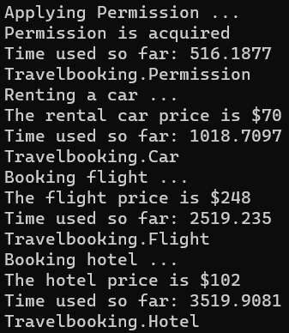
Synchronous Solution Outputs

Slide 21
Asynchronous Solution
Synchronous solution
Task class → Asynchronous solution
In Threading.Tasks namespace, Task class is designed to support asynchronous and parallel processing using multithreading model – It uses a pool of threads.
Task class
Started by Task and executed in thread pool simultaneously
Started and executed in main thread
String Apply Permission()
Task Main()
Task<Car> RentCarAsync()
Task<Hotel> BookHotelAsync()
Task<Flight> BookFlightAsync()
Synchronous
await BookHotelAsync()
await BookFlightAsync()
await RentCarAsync()
The await operator suspends current thread (free processor) until the asynchronous operation, which it waits for, completes.

Slide 22
Asynchronous Version Define Classes
using System;
using System.Threading.Tasks;
namespace TravelbookingAsync {
// The following four classes are empty for simplicity. You can add properties and methods for more details.
internal class Car { }
internal class Flight { }
internal class Hotel { }
internal class Permission { }
class Program {
static Random rng = new Random();
static void jobTime(int milisec) {
DateTime jobStart = DateTime.Now;
while (((TimeSpan)(DateTime.Now - jobStart)).TotalMilliseconds < milisec) { }
}
Delay function that holds processor to simulate the actual job time

Slide 23

Asynchronous Version Main Function
static async Task Main(string[] args) {
DateTime start = DateTime.Now; // Starting time
Permission permit = ApplyPermission();
Console.WriteLine("Time used so far: " + ((TimeSpan)(DateTime.Now - start)).TotalMilliseconds);
Console.WriteLine(permit);
var carTask = RentCarAsync();
var flightTask = BookFlightAsync(3);
var hotelTask = BookHotelAsync(2);
await carTask; // Retrieve the asynchronous result
Console.WriteLine("Car is rented");
Console.WriteLine("Time used so far: "+((TimeSpan)(DateTime.Now - start)).TotalMilliseconds);
await flightTask; // Retrieve the asynchronous result
Console.WriteLine("Flights are booked");
Console.WriteLine("Time used so far: " + ((TimeSpan)(DateTime.Now - start)).TotalMilliseconds);
await hotelTask; // Retrieve the asynchronous result
Console.WriteLine("Hotel is booked");
Console.WriteLine("Time used so far: " + ((TimeSpan)(DateTime.Now - start)).TotalMilliseconds);
}
Create variables to hold asynchronous results for retrieval. Not use Callback!
Notes:
Here u make Fn calls bfr & do other things while waiting for the O/P.

Slide 24


Asynchronous Version Functions
private static Permission ApplyPermission() {
Console.WriteLine("Applying Permission ...");
jobTime(500);
Console.WriteLine("Permission is acquired");
return new Permission();
}
private static async Task<Hotel> BookHotelAsync(int h) {
int[] price = new int[h];
int min = 1000;
Console.WriteLine("Booking hotel ... ");
for (int i = 0; i < h; i++) {
price[i] = rng.Next(100, 199);
if (price[i] < min) min = price[i];
//jobTime(500) it does not free processor;
await Task.Delay(500); // It will free processor
}
return new Hotel();
}
Still synchronous

Slide 25
Asynchronous Version Function Flight
private static async Task<Flight> BookFlightAsync(int f) {
int[] price = new int[f];
int min = 1000;
Console.WriteLine("Booking flight ... ");
for (int i = 0; i < f; i++) {
price[i] = rng.Next(200, 399);
if (price[i] < min) min = price[i];
//jobTime(500) it does not free processor;
await Task.Delay(500); // It will free processor
}
Console.WriteLine("The flight price is $" + min);
return new Flight();
}

Slide 26
Asynchronous Version Function Car
private static async Task<Car> RentCarAsync(){
Console.WriteLine("Renting a car ... ");
int price = rng.Next(50, 99);
Console.WriteLine("The rental car price is $" + price);
//jobTime(500) it does not free processor;
await Task.Delay(500); // It will free processor
return new Car();
}
}
}

Slide 27
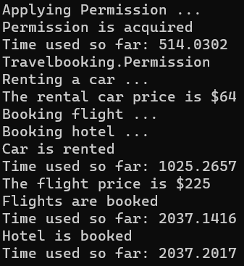
Asynchronous and Asynchronous Results
Synchronous
Asynchronous

Slide 28
Performance Metrics of Multithreading
Speedup of a program: The ratio of the base system execution time to the improved system execution time
baseExecutionTime(P)
Speedup (P) =
improvedExecutionTime(P)
8
7
6
5
4
3
2
1
Perfect scalability
speedup
Good scalability
Poor scalability
1
2
3
4
5
6
7
8
Number of cores
Notes:
baseExecutionTime ~ Synchronous time , improvedExecutionTime ~Asynchronous time

Slide 29
Amdahl’s Law (Review)
An N-core design cannot improve the speed of all components in the system.
Assume that f fraction of the system is enhanced by a factor N
baseExecTime
improvedExecTime
Speedup =
baseExecTime
(f x baseExecTime)/N + (1 – f ) x baseExecTime
=
1
f /N + (1 – f )
=

Slide 30
Example: Scalability of N-Core
1
f /N + (1 – f )
Speedup (f, N) =
Assume f = 0.9 and N = 10, 100, and 1000
1
Speedup (0.9, N=10) = = 5.3
0.9/10 + 0.1
1
Speedup (0.9, N = 100 ) = = 9.1
0.9/100 + 0.1
Speedup (0.9, N = 1000 ) = 9.9

Slide 31
Gustafson's Law, with a Different Assumption
Amdahl’s Law assumes the fraction 1- f of the serial computing part does not change when multiple cores are added. As the result, the unchanged part will become the bottle-neck, no matter how big the N is.
Gustafson's Law assumes that the fraction 1- f of the serial computing part will be improved proportionally when multiple cores are added, and thus:
speedup(f, N) = N – f (N – 1)
For Assume f = 0.9 and N = 10, 100, and 1000
f | N | Speedup = N – f (N – 1)
0.9 | 10 | 1.9
0.9 | 100 | 10.9
0.9 | 1000 | 100.9

Slide 32
Efficiency of Multi-Core Processors
Speedup measures how much faster the parallel execution is than the serial execution
Efficiency measures how well the multi-core resources are utilized.
Assume the number of cores is N and the speedup is S, relative to a single core implementation when executing program P
S(P)
Efficiency(P) =
N

Slide 33
Performance Measurements Using Many (32) Core Processor
Case Study:
Experiment Design and Implementation Considerations

Slide 34
Problem Selection: Validating Famous Conjectures
A conjecture is a proposition or theorem that appears correct, but has not been proven or disproven.
Finding counterexample is to disprove.
P ≠ NP-Complete (e.g., CSE310, CSE450, CSE551)
Beal's Conjecture (1993): Assume A, B, C are positive integers, and x, y, z > 2. If A^{x} + B ^{y} = C ^{z}, then, A, B, and C must have a common prime factor. Beal offers US$100K prize for a proof or a counterexample.
Goldbach's Conjecture (1742): Every even integer greater than 2 can be expressed as the sum of two primes.
Collatz Conjecture (1937): About program correctness (https://en.wikipedia.org/wiki/Collatz_conjecture)

Slide 35
Verifying Program Correctness
Program’s total correctness is proven in two steps:
Partial correctness: For every valid input, the program gives correct output when it terminates. Different methods exist:
Induction
Symbolic execution
Other methods
Termination: For every valid input, the program terminates in limited steps (or limited time)
Loop variable must decrease strictly

Slide 36
Collatz Conjecture (Half Or Triple Plus One)
The Collatz Conjecture:
Take any natural number n. If n is even, divide it by 2 to get n / 2; if n is odd, multiply it by 3 and add 1 to obtain 3n + 1. Repeat the process until the result is 1.
The conjecture is that no matter what number you start with, you will always reach 1 –– the program always terminates.
I started a multithreading program to validate the Collatz Conjecture or find a counterexample. I used 32-core computer to outperform many efforts people have started running years ago: My one year could be worth of other’s 32 years!
A challenge to you: Take a 64-core and start today!

Slide 37
Case Study: Efficiency Issues in Multithreading
Because the overhead of creating and starting multithreading, the speedup S of N parallel threads will be S < N.
If the overhead is so large, it is possible S < 1, meaning that the multiple threading program is slower than the single threaded program.
When comparing a multithreading program with the single threaded program, the implementations of its two programs must be fair (not biased).

Slide 38
The method to be started as a thread
class HOTPO { //Collatz conjecture: Half Or Triple Plus One
Int64 s, t;
public HOTPO(Int64 start, Int64 terminate) { // constructor
this.s = start;
this.t = terminate;
}
public void hotpoFunc() {
for (Int64 i = s; i <= t; i++) {
Int64 n = i;
while (n > 1) {
if (n % 2 == 0) // if n is even, divide by 2
n = n / 2; // Integer division
else
n = 3 * n + 1; // Multiply 3 and plus 1
}
}
}
}
This function validates all number between start and terminate

Slide 39
Experiment Design for a Core 2 Qua Computer
Creating 4 threads
Each thread processes one fourth of the numbers
All number from 1 to 4m
1
m+1
2m+1
3m+1
4m
Thread 1
Thread 2
Thread 3
Thread 4
There is no communication and coordination among the threads to maximize the speedup.

Slide 40
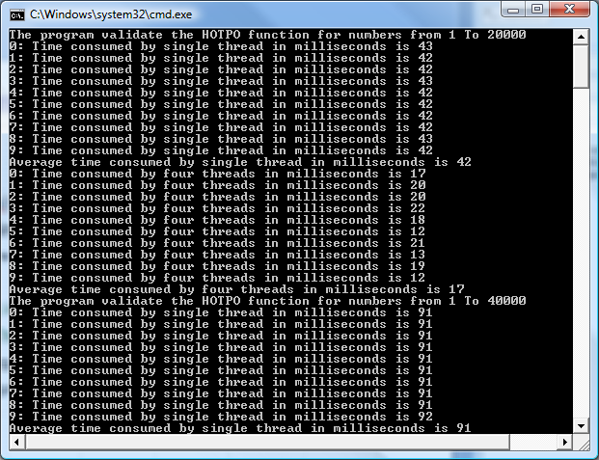
Output (Part)

Slide 41
Speedup and Efficiency on 4-Core Processor
on Intel Core 2 Quad CPU @2.40 GHz
Input Size | One thread | Four Thread | Speedup | Efficiency
20,000 | 41 | 20 | 2.05 | 51%
40,000 | 89 | 33 | 2.70 | 67%
60,000 | 139 | 49 | 2.84 | 71%
80,000 | 191 | 62 | 3.08 | 77%
100,000 | 246 | 88 | 2.80 | 70%
120,000 | 300 | 97 | 3.09 | 77%
140,000 | 359 | 101 | 3.55 | 89%
160,000 | 414 | 119 | 3.48 | 87%
180,000 | 472 | 149 | 3.17 | 79%
200,000 | 513 | 153 | 3.35 | 84%
Average Speedup = 3.01
Time in milliseconds
Efficiency = Speedup / Cores
Average Efficiency = 75%

Slide 42
Speedup and Efficiency Observation on 4 Cores
The bigger the problem is, the more efficient are the multi-core and multithreading techniques.
The curves are not straight, as other tasks are running on the computer
The growth slows down when the problem is too big
On single core
On four cores
Collatz conjecture validation execution time, speedup, and efficiency with different problem sizes

Slide 43

Further Experiment on Intel 32-Core MTL
ASU supercomputer center has much faster computer today:
https://rcstatus.asu.edu/
Questions to explore
What would happen if we make use of more cores by increasing the number of parallel threads?
Can the execution time, speedup, and efficiency improve proportionally to the number of cores (scale up)?
What are overheads by increasing the number of threads?
Experiments
The same program is executed in 1, 4, 8, 16, and 32 threads on the 32-core machine in Intel Many-core Testing Lab (MTL);
The times are measured, and speedup and efficiency are calculated

Slide 44
Experiment Design for a 32-Core Computer Attempt 1
Creating 1, 4, 8, 16, 32 threads
Each thread takes a part (1milliom) of the numbers. For 32 threads:
Map
Reduce
. . .
1
32m
Thread 1
Thread 3
Thread 4
Thread 5
Thread 6
Thread 7
Thread 8
Thread 10
Thread 11
Thread 2
Thread 9
Thread 12
Thread 14
Thread 32
Thread 13
. . .
Spin Synchronization
Reduce
Conclusion: Find a solution or not
Notes:
Map reduce – Auto cutting of a problem into small chunks e.g. in BigData.

Slide 45
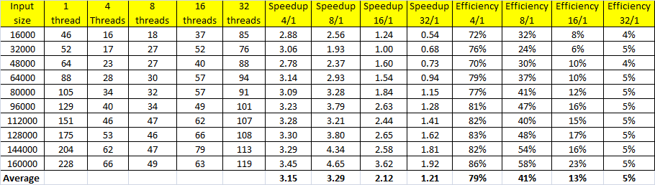
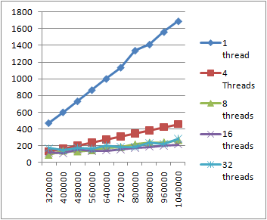
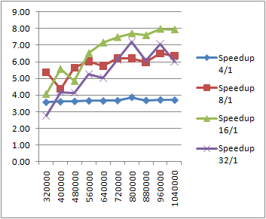
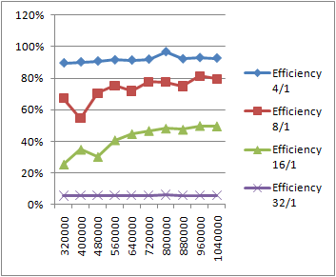
Experiment Data From Attempt 1
Time measured in milliseconds
Speedup
Efficiency
Input
size

Slide 46
Analysis: 32-Core Attempt 1
The 4-thread performance (3.15 – 79%) of the 32-core is slightly better than that on the 4-core (Core 2 Qua).
The 8-thread performance is the highest (3.29 – 41%), but the efficiency is 41% only.
The 16-thread performance is much worse, and 32-core performance is the worst.
What is wrong?
The simple partition is to blame:
The first subset has all the small numbers, while the last subset has all the large number;
The slowest thread counts for the performance.

Slide 47
Problem of Attempt 1
Creating 32 threads, each thread compute 1/32 of the numbers.
1st million
2nd million
3rd million
31st million
32nd million
Thread 1
Thread 2
Thread 3
Thread 31
Thread 32
Spin & wait for all threads to complete
Spin Synchronization
Conclusion: Find a solution or not

Slide 48
Using Modulo Operation for Input Partition Attempt 2
To give each thread balanced numbers (mix of small and large), we use modulo operation;
We use N arrays (0.. N-1) to store the numbers to be validated;
One thread program uses one array
32-threads use 32 arrays
The number with residue r goes into array r;

Slide 49
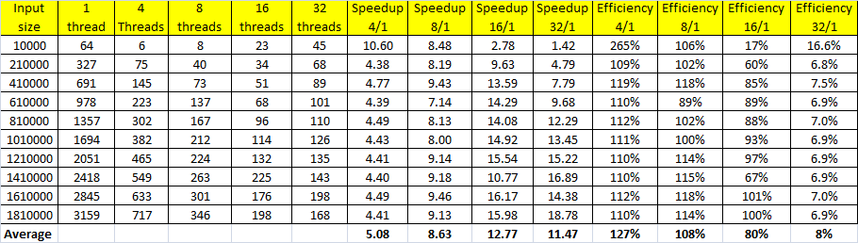
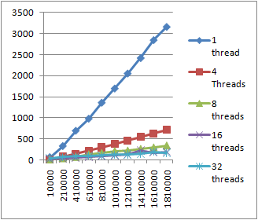
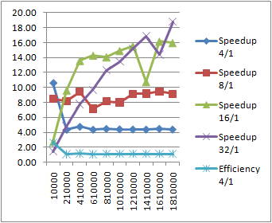
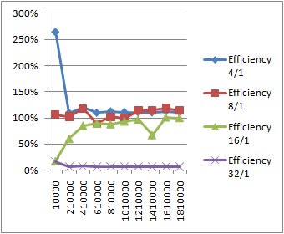
Experiment Data From Attempt 2
Time measured in milliseconds
Speedup
Efficiency
Input
size

Slide 50
Analysis: 32-Core Attempt 2
The 4-thread performance (5.08 – 127%) against the 1-thread implementation.
The 8-thread performance is the highest (8.63 – 108%).
The 16-thread performance is the highest (12.77 - 80%).
What is wrong?
The single thread is unfairly implemented:
The single thread program uses a single large array;
The 32-thread program uses 32 smaller arrays;
The memory management of the system must have placed the large array far from the processor, resulting in slower data access. Data structure impact dominates.

Slide 51
Performance: of the 32-Core Attempt 3 The Final Version
To be fair to all implementations, we use 32 arrays no matter the number of threads
32 arrays for one-thread program
List of arrays stored
partitioned numbers
One Thread
All numbers to be validated
Thread 1
Store in 32 arrays
. . .

Slide 52
Performance: of the 32-Core Attempt 3 The Final Version
32 arrays for 32 threads
List of arrays stored
partitioned numbers
Number mod T
Single-thread implementation
1
Switch
1
All numbers to be validated
2
. . .
. . .
Input Partition
32
Multithread implementation

Slide 53
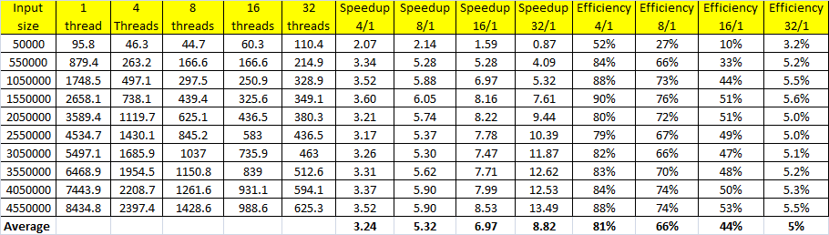
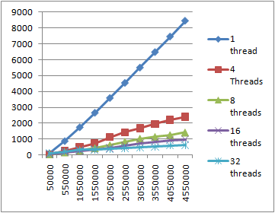
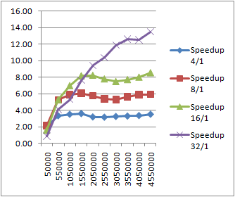
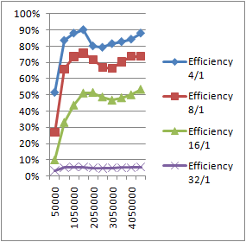
Experiment Results on Intel 32-Core MTL
The Final Version
Time measured in milliseconds
Speedup
Efficiency
Input
size

Slide 54
Analysis of the Experiment Results
Fair implementations are critical for comparison
Execution Time Measured
Increasing threads makes use of more cores and reduces the execution time;
The overhead can exceed the time saved by parallel execution once the thread number becomes too big.
The bigger the input size is, the more time is saved.
Speedup (improvement against single thread)
The trend is similar to the trend of execution time
Efficiency
Due to the overhead added by managing multithreading, the more threads are used, the lower the efficiency.
The bigger the input size, the more efficient

Slide 55
Appendix: Complete Code
Not required

Slide 56
The Complete Program (Attempt 3)
namespace Collatz {
class HOTPO {
List<Int64> vs;
public HOTPO(List<Int64> validationSet) {
vs = validationSet;
}
public void hotpoFunc() { //Collatz conjecture: Half Or Triple Plus One
foreach(Int64 e in vs) {
Int64 n = e;
while (n > 1) {
if (n % 2 == 0) // if n is even
n = n / 2; // Integer division
else
n = 3 * n + 1;
} } } }
The function of
Half Or Triple Plus One
The function of
Half Or Triple Plus One.
The function will be started as threads

Slide 57
The Program (Console Application)
Prepared for executing the program in multiple iterations for building average results
class Program {
static void Main(string[ ] args) {
Int64 repeatNo = 10;
for (Int64 k = 0; k <= 5; k++) { // threadnum = 1, 2, 4, 8, 16, 32
Int64 threadnum = (Int64)System.Math.Pow(2, k);
for (Int64 r = 1; r <= 100; r = r + 10) {
float totalTime = 0;
Int64 t = r * 50000; // define the step length of iteration
Console.Write("The program validate HOTPO function for numbers ");
Console.WriteLine("from 1 To " + t);
try {
HOTPO[] h = new HOTPO[32];
List<Int64>[] vSetList = new List<Int64>[32];
for (Int64 i = 1; i <= t; i++) {
if (vSetList[i % 32] == null)
vSetList[i % 32] = new List<Int64>();
vSetList[i % 32].Add(i);
}
Load the data into the list of arrays

Slide 58
Partition Inputs into a List of Array
Thread[] ht = new Thread[32]; // create 32 thread object
for (int i = 0; i < repeatNo; i++) {
DateTime startMT = DateTime.Now;
for (Int64 b = 0; b < threadnum; b++) {
for (Int64 count = 0; count < (Int64)System.Math.Pow(2, k); count++){
Int64 cc = 0;
for (Int64 m = 0; m < 32; m++) {
Int64 c = b % threadnum;
Int64 d = m % threadnum;
if (c == d) {
if (h[c] == null)
if (c != m)
vSetList[c].AddRange(vSetList[m].ToArray());
} cc = c;
} h[cc] = new HOTPO(vSetList[cc]);
}
}
Distribute the numbers into the data arrays.

Slide 59
Create and Start Threads
Create t objects for t threads
for (int g = 0; g < threadnum; g++)
ht[g] = new Thread(new ThreadStart(h[g].hotpoFunc));
for (int g = 0; g < threadnum; g++)
ht[g].Start();
bool itag = true;
while (itag) {
itag = false;
for (int g = 0; g < threadnum; g++)
if (ht[g].IsAlive)
itag = true;
};
float manyThreadTime = (DateTime.Now - startMT).Seconds;
if (manyThreadTime < 0)
Console.WriteLine(i + ": Error");
Start threadnum of threads in a loop.

Slide 60
Calculate the Time Used
if (manyThreadTime != 0) {
manyThreadTime = manyThreadTime * 1000 + (DateTime.Now - startMT).Milliseconds;
} else
manyThreadTime = (DateTime.Now - startMT).Milliseconds;
totalTime = totalTime + manyThreadTime;
Console.WriteLine(i + ": Time consumed by " + threadnum + " threads in milliseconds is " + manyThreadTime);
}
}
finally { }
Console.WriteLine("Average time consumed by " + threadnum + " threads in milliseconds is " + totalTime / repeatNo); ;
}
} Console.ReadLine();
}
}
}

Slide 61
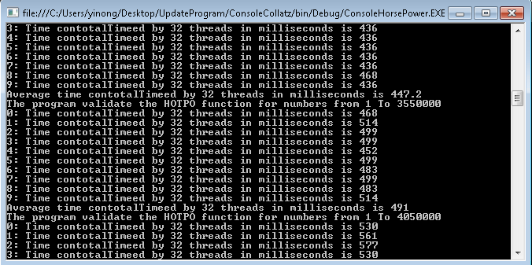
Output (Part)

Slide 62
Multithreading Performance with Communication and Synchronization
The threads in Collatz Conjecture validation program are independent of each other.
How much performance can be improved if communication and synchronization are involved among the threads?

Slide 63
Performance with Thread Communication
Consider the e-commerce system in the diagram
The threads share the multi-cell buffer;
Is the encoder or decoder a bottleneck of performance?
Should the order-processing threads be created in Hotel thread? What are TBB ideas?
When do we need “Spin Synchronization”?
Main
Decoder
Order
Object
Threads
A thread is created for each order request
Agency
1
String
String
OrderObject
String
Encoder
. . .
object
String
Hotel thread
OrderProcessing Thread
Order
Object
object
Agency
N
object
OrderProcessing Thread
Multi-cell buffer
with semaphore
. . .
String
Event subscription
OrderProcessing Thread
Event callback

Slide 64
Chapter 2 Summary
General Issues in Distributed Computing
Resource sharing, deadlock, and deadlock handling, synchronization
Creating child process in operating system (Unix)
Multithreading in Java and in Python
Multithreading in C#
Monitors / Lock / Conditional Monitors, Reader/Writer Locks / Mutex / Semaphores
Coordination events: define orders of thread execution
Delegate for creating event service & event-driven programming
Even-driven programming and delegate
Delegates and callbacks
Performance and efficiency of Async and multithreading
Synchronous vs. asynchronous
Impact of implementation issues

